Slide 1
Additional Features for SACP
By: Talha Ahmad (Team Lead)

Slide 2

Introduction
In this presentation we will discuss some interesting features to add into Smart Academic Communication Platform, so that it won’t become a typical automated email sender application. I’ll present you twelve ideas so that we can decide which feature is useful to solve core communication problem among faculty and students as well as design a technical approach to add these features into our application.
This Photo by Unknown Author is licensed under CC BY-SA

Slide 3
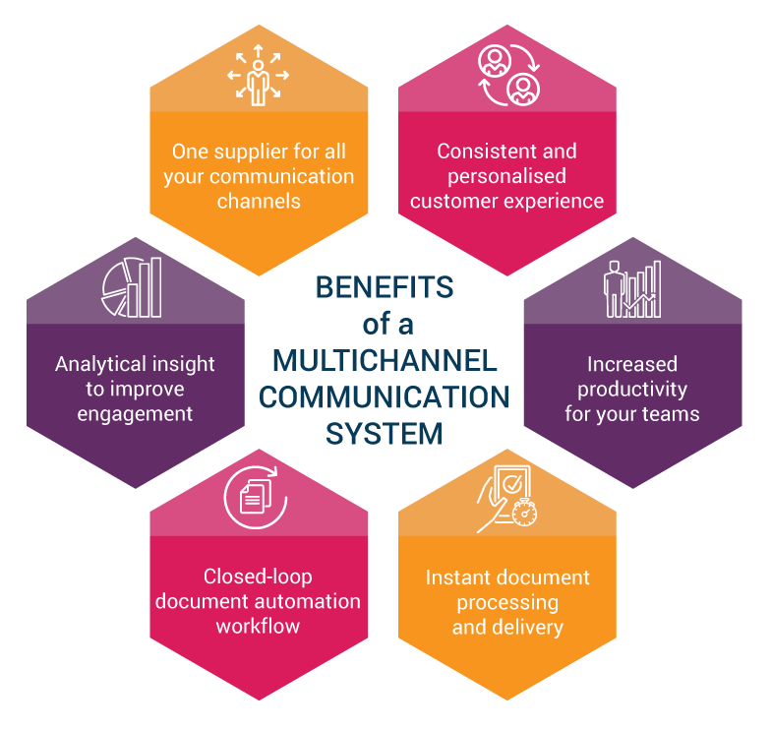
1. Multi-channel Communication
Think of it like you’ve multiple options to achieve a specific goal and you’ve to choose to correct one based on your specific criteria. Similarly, multi-channel communication support provides multiple options for faculty members and students to keep them engaged and boost productivity. There’re some common channels:
  Email
  SMS
  In-app

Slide 4
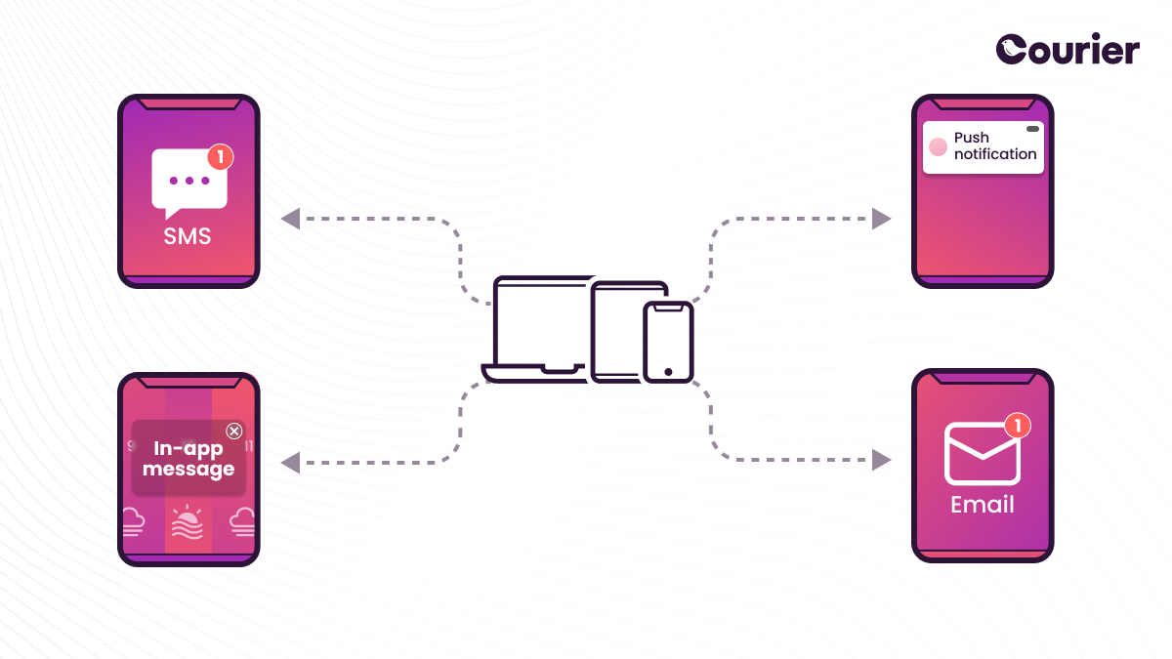
2. In-app Notification System
This feature allows users to view unseen notifications of any type. Whenever a faculty member send some announcement, targeted audience (students) will receive its notification inside the application. This is a small feature but best for engagement and productivity.

Slide 5
3. Actionable Communications
Don’t just throw static messages, we can make them actionable e.g.,

